Slide 1
Inheritance And Exception Handling

Slide 2
Inheritance
Inheritance is the capability of one class to derive or inherit the properties from some another class.
It provides reusability of a code. We don’t have to write the same code again and again. Also, it allows us to add more features to a class without modifying it.
If class B inherits from another class A, then all the subclasses of B would automatically inherit from class A.
Parent class is the class being inherited from, also called base class.
Child class is the class that inherits from another class, also called derived class.

Slide 3
Parent class and Child class
class Profile:
def __init__(self, name, address):
self.name = name
self.address = address
class Hr(Profile):
def info(self):
print(self.name, self.address)
x = Hr(“Ram”, “Nepal”)
x.info()

Slide 4
Example:
class Profile:
def __init__(self, name, address):
self.name = name
self.address = address
def info(self):
print(self.name, self.address)
class Student(Profile):
def __init__(self, name, address, country):
Profile.__init__(self, name, address)
self.country = country
def hello(self):
print("Hello, welcome", self.name,"from", self.address, "to ", self.country)
x = Student("John", "USA", "Nepal")
x.hello()

Slide 5
Python - public, private and protected Access
Public members (generally methods declared in a class) are accessible from outside the class. The object of the same class is required to invoke a public method.
Protected members of a class are accessible from within the class and are also available to its sub-classes. No other environment is permitted access to it. A variable that is protected can only be accessed by its own class and any classes derived from it.
Private members of a class are denied access from the environment outside the class. They can be handled only from within the class.

Slide 6
Public Attributes
class employee:
def __init__(self, name, sal):
self.name=name
self.salary=sal

Slide 7
Protected Attributes
class employee:
def __init__(self, name, sal):
self._name=name # protected attribute
self._salary=sal # protected attribute

Slide 8
Private Attributes
class employee:
def __init__(self, name, sal):
self.__name=name # private attribute
self.__salary=sal # private attribute

Slide 9
Private
class Car():
def __init__(self, name = 'Ram', age = 30, year = '1971', add = 'USA',
color = 'black'):
self.__name = name
self._age = age
self.__year = year
self.__add = add
self._color = color
def move_forward(self, name):
print(f"Hello My name is {self.__name}. {name} I am from {self.__add}.")
def move_backward(self, age):
print(f"Hello My name is {self.__name}.I am {self._age}. {age}")
mycar = Car()
print(mycar._color) # changing to mycar.move_forward(100)
mycar.move_forward("Ajaya")
mycar.move_backward("50")

Slide 10
Exception Handling
An exception is an error that happens during execution of a program. When that error occurs.
Python generate an exception that can be handled, which avoids our program to crash.
Raising an exception breaks current code execution and returns the exception back until it is handled.
You can raise an exception in your own program by using the raise exception statement

Slide 11
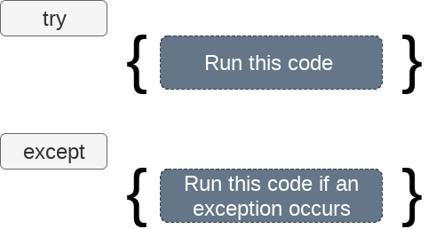
Syntax:
try :
#statements in try block
except :
#executed when error in try block

Slide 12
Example:
try:
age = int(input(“Age : ”))
print(age)
except ValueError:
print(“Invalid Value:Please enter age:”)
------------------------------------------------------------------------------
try:
age = int(input(“Age : ”))
print(age)
except ValueError:
print(“Invalid Value:Please enter age:”)
else:
print(“No error”)

Slide 13
Examples
try:
x=2
y='0'
print(x/y)
except:
print('Some error occurred.')

Slide 14
Examples…
try:
x=5
y='0'
print (x+y)
except TypeError:
print('Unsupported operation')

Slide 15
Multiple except blocks
try:
x=3
y=0
print (x/y)
except TypeError:
print('Unsupported operation')
except ZeroDivisionError:
print ('Division by zero not allowed')

Slide 16
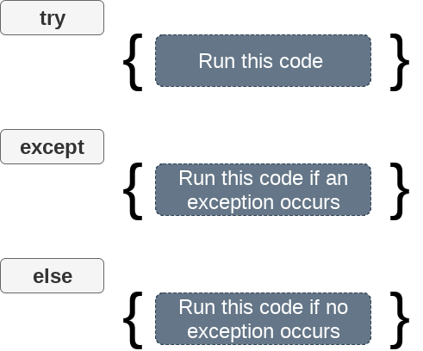
Try,except,else
try:
x = int(input("Enter x:"))
y = int(input("Enter y:"))
z= x/y
except Exception:
print("can't divide by zero")
else:
print(“No error Further operation")

Slide 17
Try,except,else
try:
#this will throw an exception if the file doesn't exist.
b = open(“book.txt","r")
except IOError:
print("File not found")
else:
print("The file opened successfully")
b.close()

Slide 18
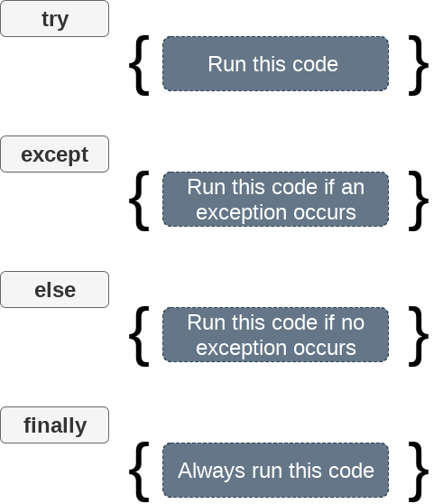
Try,except,else,finally

Slide 19
Try,finally,except
try:
fileptr = open(“book.txt","r")
try:
fileptr.write("Hi I am good")
finally:
fileptr.close()
print("file closed")
except:
print("Error")

Slide 20
else and finally
try:
#statements in try block
except:
#executed when error in try block
else:
#executed if try block is error-free
finally:
#executed irrespective of exception occured or not

Slide 21
else and finally
try:
print("try block")
x=int(input('Enter a number: '))
y=int(input('Enter another number: '))
z=x/y
except ZeroDivisionError:
print("except ZeroDivisionError block")
print("Division by 0 not accepted")
else:
print("else block")
print("Division = ", z)
finally:
print("finally block")
x=0
y=0
print ("Out of try, except, else and finally blocks." )

Slide 22
Try,raise,else,except
try:
a = int(input("Enter a?"))
b = int(input("Enter b?"))
if b == 0:
raise ArithmeticError
else:
print("a/b = ",a/b)
except ArithmeticError:
print("The value of b can't be 0")

Slide 23
Python - Assert Statement
Python provides the assert statement to check if a given logical expression is true or false.
Program execution proceeds only if the expression is true and raises the AssertionError when it is false.
num=int(input('Enter a number: '))
assert num>=0
print('You entered: ', num)

Slide 24
Python - Assert Statement
try:
num=int(input('Enter a number: '))
assert(num >=0)
print(num)
except AssertionError :
print(“Error”)

Slide 25
Home Work
Discover Different exceptions handling and solve all those.

